Slide 1
Cascading style sheets

Slide 2
The good, the bad and the… ugly!
<p>
<font face="Arial">Shashdot.</font>
News for <b>nerds!!</b> You will <i>never</i>, <u>EVER</u> be
<font size="+4" color="red">BORED</font> here!
</p> HTML
Slashdot. News for nerds!! You will never, EVER be BORED here!
output
Tags such as b, i, u, and font are discouraged in HTML5
Why is this bad?

Slide 3
Cascading style sheet
Not a language
Describes the appearance, layout, and presentation of information on a web page
HTML describes the content of the page
Describes how information is to be displayed, not what is being displayed
Can be embedded in HTML document or placed into separate .css file

Slide 4
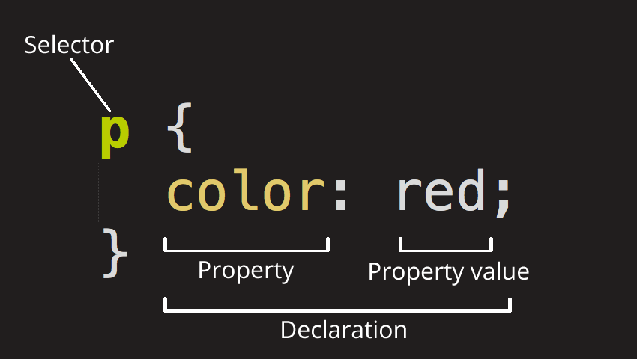
Basic CSS rule syntax
selector {
property: value;
property: value;
property: value;
} CSS
A CSS file consists of one or more rules
Each rule starts with a selector
A selector specifies an HTML element(s) and then applies style properties to them

Slide 5
Example
p {
font-family: sans-serif;
}
#xyz{
color: red;
}
abc{
font-style: italic;
}

Slide 6
3 ways of writing css
Inline
Internal
external

Slide 7
Inline CSS
Rule is written in the tag itself and You can apply these rules only to that element
Use style attribute to do it.
Higher precedence than embedded or linked styles
Used for one-time overrides and styling a particular element
Bad style and should be avoided when possible (why?)

Slide 8
Example
<p style="font-family: sans-serif; color: red;">
This is a paragraph
</p>

Slide 9
Internal CSS
You simply put the CSS code within the <head> </head> tags of each HTML file you want to style.
Use style tag to do it

Slide 10
Example
<head>
<title>Title of the document</title>
<style>
body {
background-color: #1c87c9;
}
p {
color: white;
}
</style>
</head>

Slide 11
External Style sheet:
Write CSS code in one file and include the file name in the HTML file where you want to apply the style using link tag
A page can link to multiple style sheet files
In case of a conflict (two sheets define a style for the same HTML element), the latter sheet's properties will be used
<head>
<link href=“design.css" type="text/css" rel="stylesheet" />
</head> HTML

Slide 12
Selectors
Tag selectors p{ }
ID Selector
<p id=“xyz”> #xyz{ }
Class selector
< p class=“abc”> .abc{ }
Attribute selector
img[src]
selects <img src="myimage.png">

Slide 13
Pseudo-class selector
a:hover
selects <a>, but only when the mouse pointer is hovering over the link.
a:visited will match all <a> elements that have been visited by the user.
Universal selector:
The universal selector is indicated by an asterisk (*). It selects everything in the document

Slide 14
Some child selectors
h1, h2, h3 { color: Maroon; }
The , selector is a grouping method
These are descendant selectors
article h2 { color: Blue; }
p.xyz div { color: Blue; }
In the above 2 cases, be aware that not only direct children are targeted - also children of the child (grandchildren) and so on will be targeted, all the way down through the hierarchy
Example of descendant selector
<h2>...</h2>
<article>
<h2>This heading will be selected</h2>
<div>
<h2>This heading will be selected</h2>
</div>
</article>

Slide 15
Example of Direct Child Selector
<p>...</p>
<article class=“xyz”>
<p>This paragraph will be selected</p>
<div>
<p>...</p>
</div>
</article>
<article>
…………….
</article>
article.xyz> p { color: Blue; }
The > combinator selects nodes
that are direct children of the
first element

Slide 16
<p>...</p>
<section>
<p>...</p>
<h2>...</h2>
<p>This paragraph will be selected</p>
<div>
<p>...</p>
</div>
<p>This paragraph will be selected</p>
</section>
h2 ~ p { font-style: italic; }
This selector is a general sibling
selector that looks for p elements
that follow and share the same
parent, of any h2 elements.

Slide 17
Example:
<p>...</p>
<section>
<p>...</p>
<h2>...</h2>
<p>This paragraph will be selected</p>
<div>
<p>...</p>
</div>
<p>...</p>
</section>
h2 + p { font-style: italic; }
This is Adjacent sibling combinator.
The + combinator matches the
second element only if it
immediately follows the first
element.

Slide 18
Additional selectors
In addition to the above specified selectors, we sometimes can use
Functions(): Like calc(), rotate()- These are transform functions in CSS
Example: width: calc(90% - 30px);
@rules : Like media and import
@media (Example: @media (min-width: 30em) {
body {
background-color: blue;
}
}
@import (Example: @import "styles2.css";)

Slide 19
Comments in CSS
Anything in CSS between /* and */ is a CSS comment.
The browser ignores comments as it renders the code.
CSS comments are a way for you to write helpful notes about your code or logic.

Slide 20
Some exercises to solve: Identify where to use the following rules?
h1.highlight {
background-color: pink; }
.highlight {
background-color: yellow;}
.notebox.warning {
border-color: orange;
font-weight: bold; }

Slide 21
The font property
font-family
font-size
font-stretch
font-style
font-variant
font-weight
line-height

Slide 22
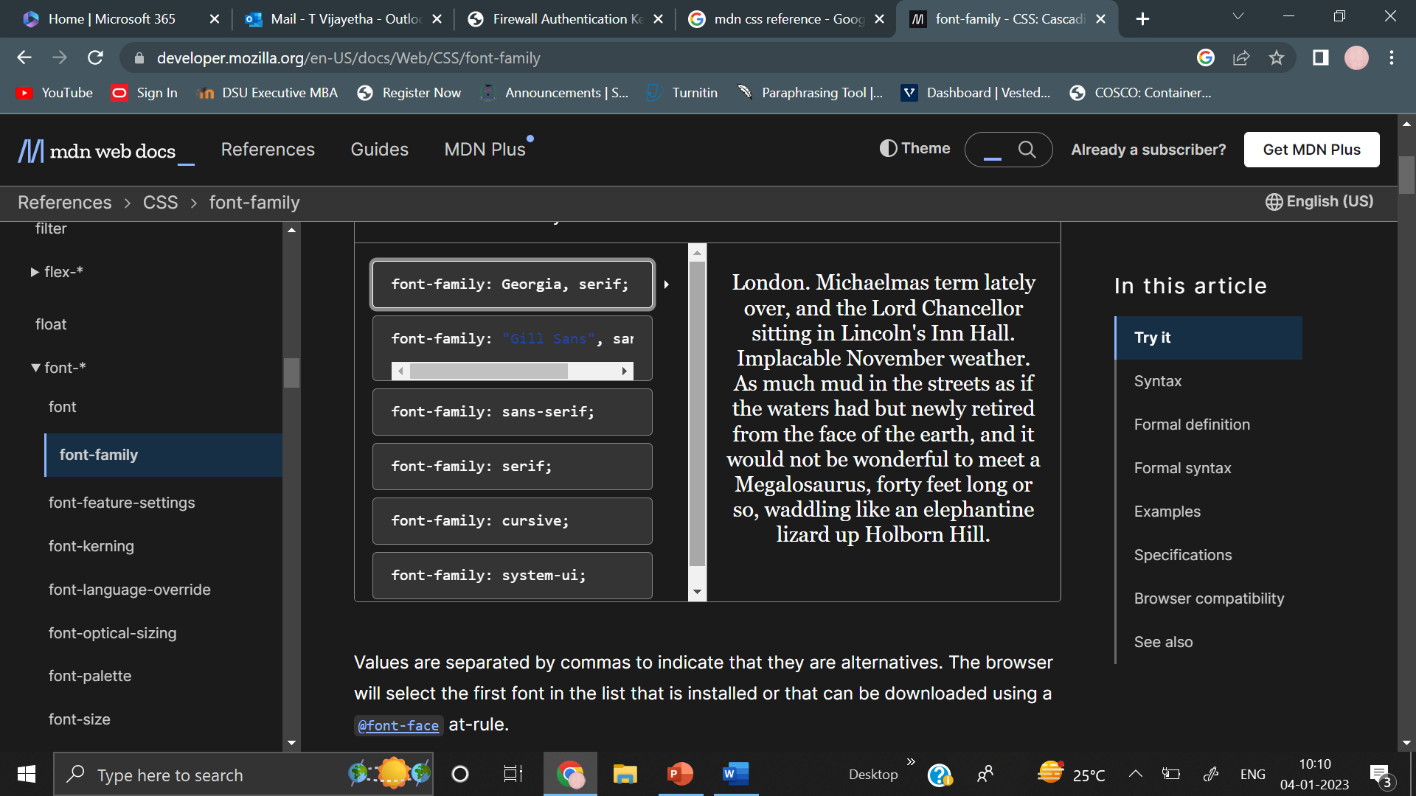
font family: The font-family CSS property specifies a prioritized list of one or more font family names and/or generic family names for the selected element.
/* Global values */
font-family: inherit;
font-family: initial;

Slide 23
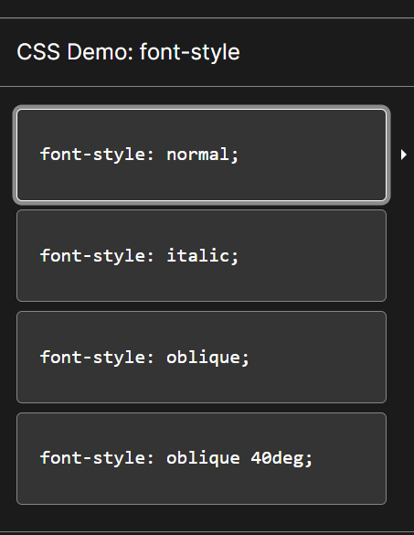
font style: The font-style CSS property sets whether a font should be styled with a normal, italic, or oblique face from its font-family.
/* Global values */
font-style: inherit;
font-style: initial;

Slide 24
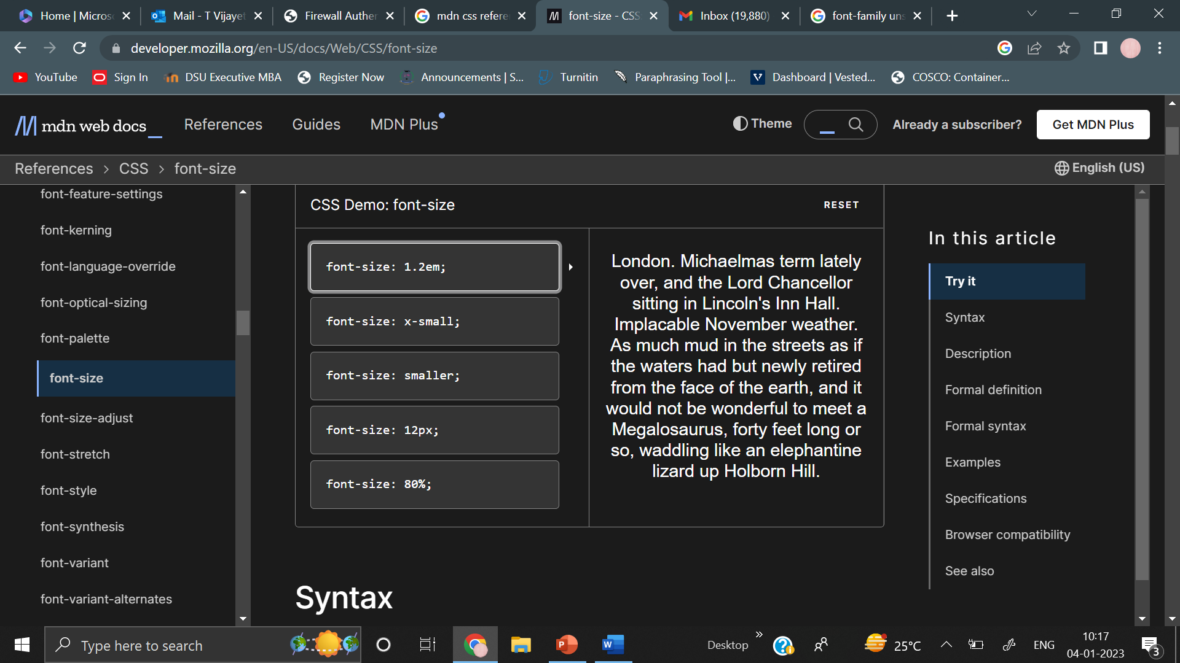
font size : The font-size CSS property sets the size of the font
If a parent element is set to 16px and its
child element is set to larger, the child element
displays larger than the parent element on the
page.

Slide 25
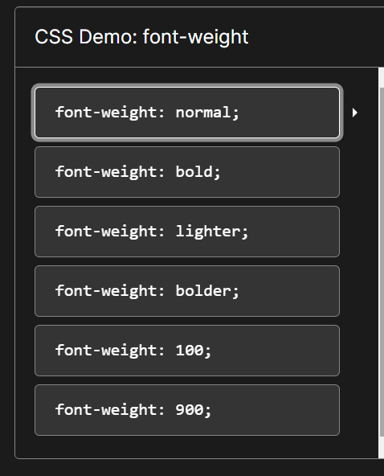
font weight : The font-weight CSS property sets the weight (or boldness) of the font

Slide 26
Line height: The line-height CSS property sets the height of a line box. It's commonly used to set the distance between lines of text
/* Keyword value */
line-height: normal;
/* Unitless values: use this number multiplied
by the element's font size */
line-height: 3.5;
/* <length> values */
line-height: 3em;
/* <percentage> values */
line-height: 34%;
/* Global values */
line-height: inherit;
line-height: initial;

Slide 27
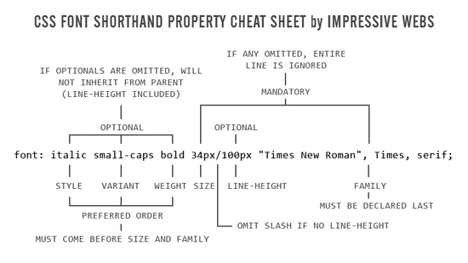
shorthand property font
font: 1.2em "Fira Sans", sans-serif;
font: italic 1.2em "Fira Sans", serif;
font: italic small-caps bold 16px/2 cursive;
font: small-caps bold 24px/1 sans-serif;

Slide 28
background:The background shorthand CSS property sets all background style properties at once, such as color, image, origin and size, or repeat method.
background-attachment
background-clip
background-color
background-image
background-origin
background-position
background-repeat
background-size

Slide 29
/* Using a <background-color> */
background: green;
/* Using a <bg-image> and <repeat-style> */
background: url("test.jpg") repeat-y;
/* Using a <box> and <background-color> */
background: border-box red;
/* A single image, centered and scaled */
background: no-repeat center/80% url("../img/image.png");
/* Global values */
background: inherit;
background: initial;

Slide 30
The background-attachment CSS property sets whether a background image's position is fixed within the viewport, or scrolls with its containing block.
background-attachment: scroll;
The background is fixed relative to the element itself and does not scroll with its contents.
background-attachment: fixed;
The background is fixed relative to the viewport. Even if an element has a scrolling mechanism, the background doesn't move with the element.

Slide 31
The background-image CSS property sets one or more background images on an element.
background-image: url(“sample.jpg”);
background-image: url(“sample.jpg"), url(“sample1.png");

Slide 32
The background-position CSS property sets the initial position for each background image. The position is relative to the position layer set by background-origin.
/* Keyword values */ background-position: top; background-position: bottom; background-position: left; background-position: right; background-position: center; /* <percentage> values */ background-position: 50% 50%; /* <length> values */ background-position: 0 0; background-position: 1cm 2cm; background-position: 10px 8em; |  | /* Multiple images */ background-position: 0 0, center; /* Edge offsets values */ background-position: bottom 10px right 20px; background-position: right 3em bottom 10px; background-position: bottom 10px right; background-position: top right 10px;

Slide 33
The background-size CSS property sets the size of the element's background image. The image can be left to its natural size, stretched, or constrained to fit the available space.
/* Keyword values */ background-size: cover; background-size: contain; /* One-value syntax */ /* the width of the image (height becomes 'auto') */ background-size: 50%; background-size: 3.2em; background-size: 12px; background-size: auto; /* Two-value syntax */ /* first value: width of the image, second value: height */ background-size: 50% auto; background-size: 3em 25%; background-size: auto 6px; background-size: auto auto; | /* Multiple backgrounds */ background-size: auto, auto; background-size: 50%, 25%, 25%; background-size: 6px, auto, contain;

Slide 34
contain : Scales the image as large as possible within its container without cropping or stretching the image
Cover: Scales the image (while preserving its ratio) to the smallest possible size to fill the container
Auto: Default value. The background image is displayed in its original size

Slide 35
The background-repeat CSS property sets how background images are repeated. A background image can be repeated along the horizontal and vertical axes, or not repeated at all.
* Keyword values */ background-repeat: repeat-x; background-repeat: repeat-y; background-repeat: repeat; background-repeat: space; background-repeat: round; background-repeat: no-repeat; /* Two-value syntax: horizontal | vertical */ background-repeat: repeat space; background-repeat: repeat repeat; background-repeat: round space; background-repeat: no-repeat round; | /* Global values */ background-repeat: inherit; background-repeat: initial;

Slide 36
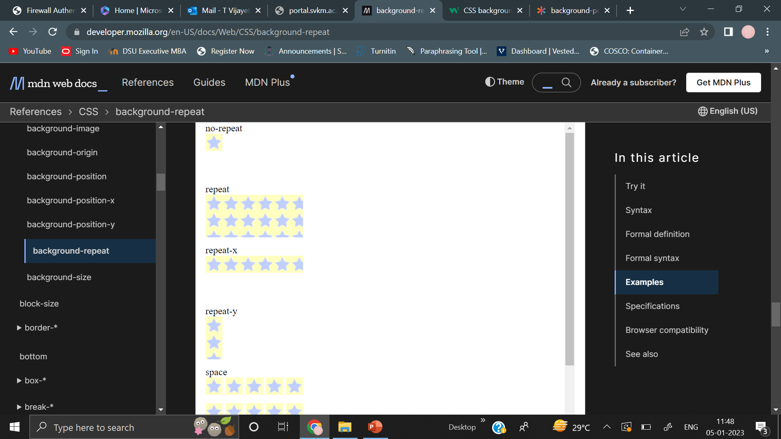
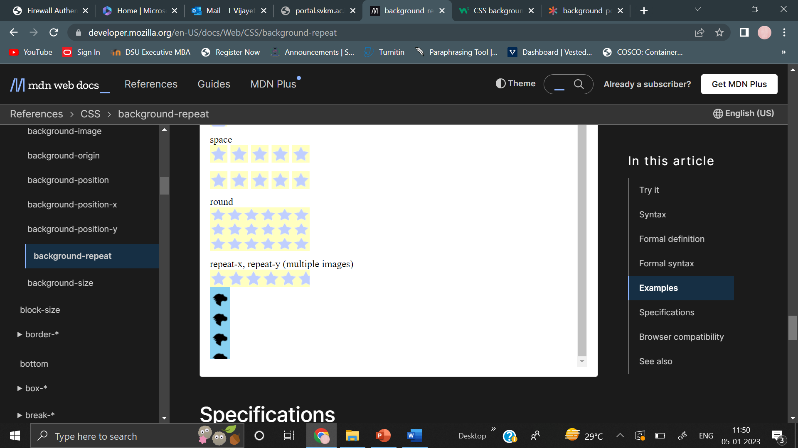

Slide 37
Border: The border shorthand CSS property sets an element's border. It sets the values of border-width, border-style, and border-color.
/* style */
border: solid;
/* width | style */
border: 2px dotted;
/* style | color */
border: outset #f33;
/* width | style | color */
border: medium dashed green;
/* Global values */
border: inherit;
border: initial;

Slide 38
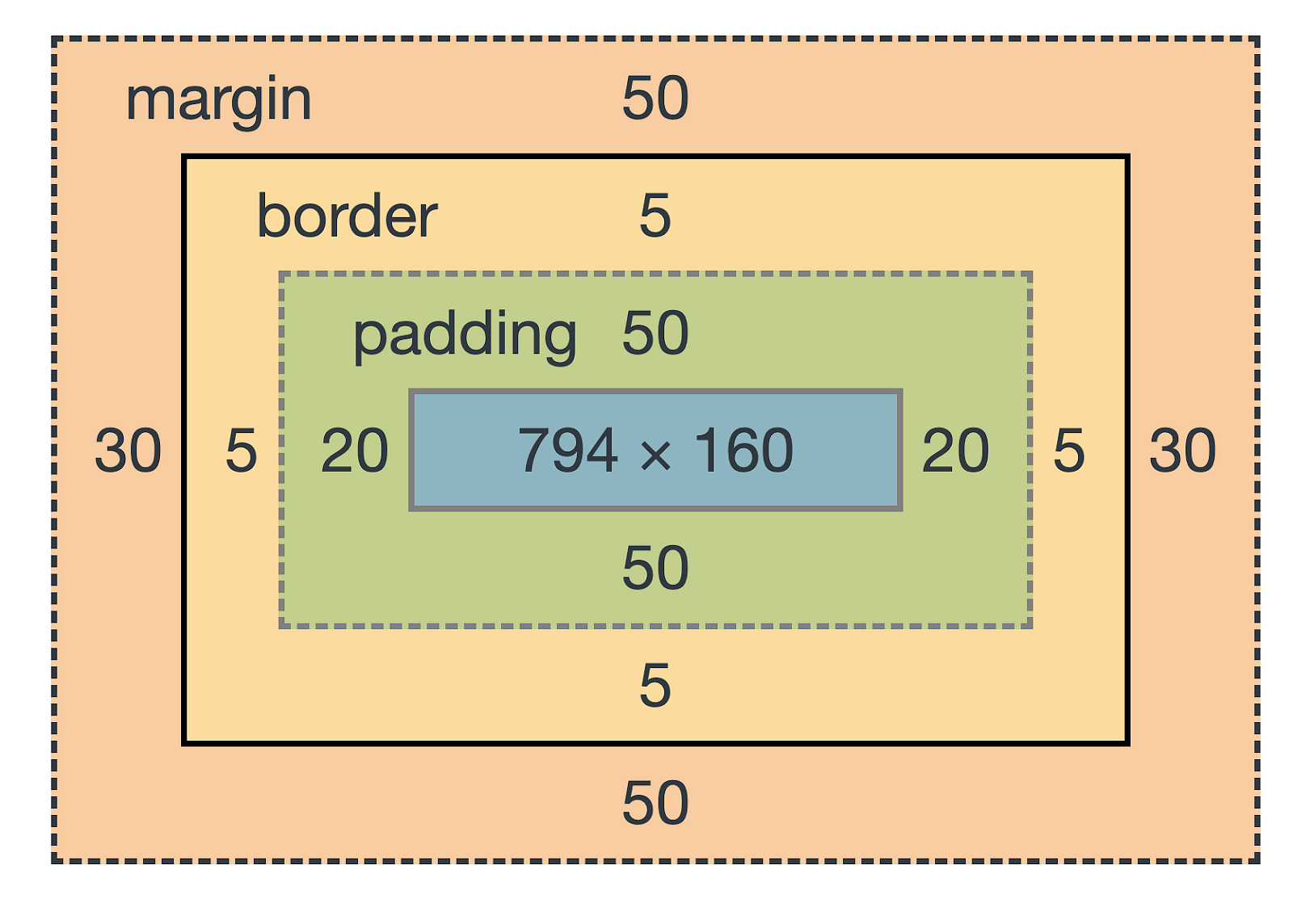
CSS box model

Slide 39
Content
The content area consists of content like image, text, or other forms of media content. The height and width properties help to modify the box dimensions.
The width CSS property sets an element's width. By default, it sets the width of the content area, but if box-sizing is set to border-box, it sets the width of the border area.
An example for the same is given in next slide

Slide 40
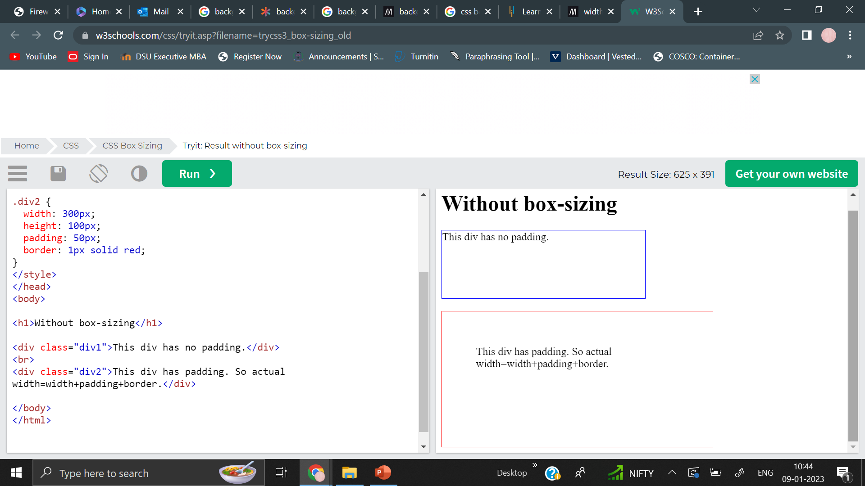
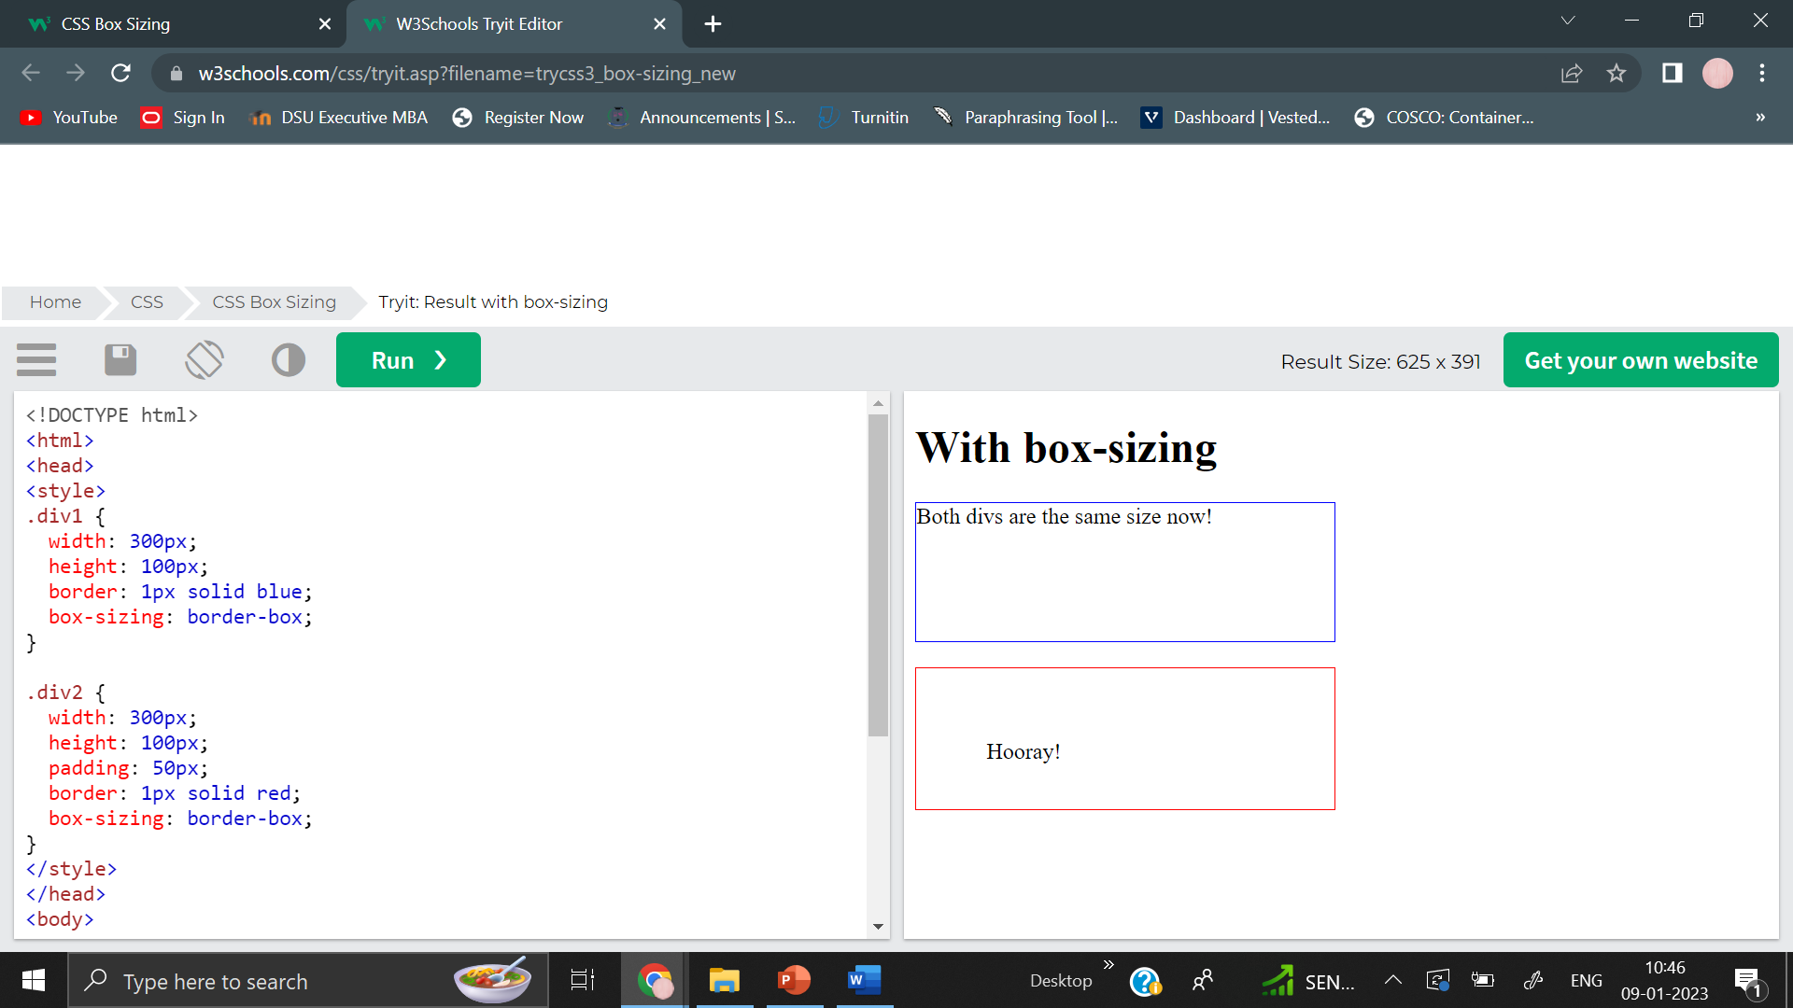
.div1 { width: 300px; height: 100px; border: 1px solid blue; } | .div2 { width: 300px; height: 100px; padding: 50px; border: 1px solid red; } | .div1 { width: 300px; height: 100px; border: 1px solid blue; box-sizing: border-box; }

Slide 41
Padding
The padding area is the space around the content area and within the border-box. It can be applied to all sides of the box or to the specific, selected side(s) - top, right, bottom, and/or left.
The thickness of the padding is determined by the padding-top, padding-right, padding-bottom, padding-left, and shorthand padding properties.

Slide 42
Border
The border area surrounds the padding and the content, and can be applied to all the sides of the box or to selected side(s) - top, right, bottom, and/or left.

Slide 43
Margin
The margin area consists of space between the border and the margin. The margin does not possess its own background color and is completely transparent. It shows the background color of the element, like the body element.
The size of the margin area is determined by the margin-top, margin-right, margin-bottom, margin-left, and shorthand margin properties. When margin collapsing occurs, the margin area is not clearly defined since margins are shared between boxes.

Slide 44
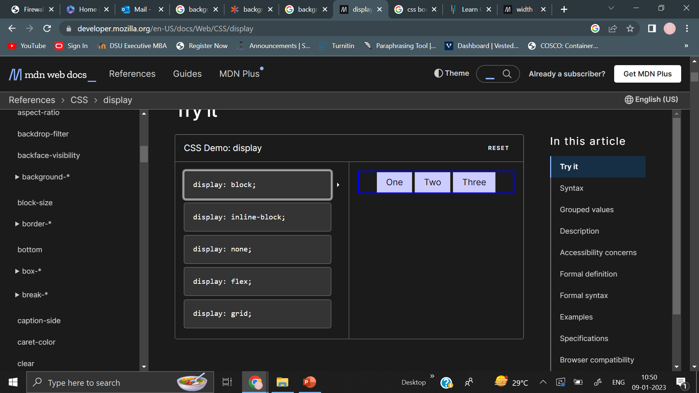
display property
The display CSS property sets whether an element is treated as a block or inline element and the layout used for its children, such as flow layout, grid or flex.
Outside properties
display:block
The element generates a block element box, generating line breaks both before and after the element when in the normal flow.

Slide 45
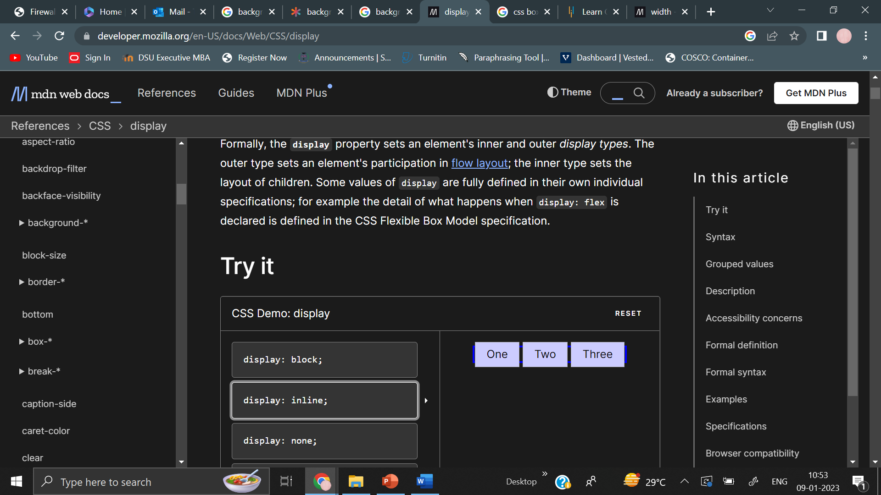
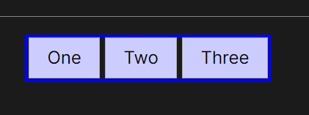
display:inline
display:inline-block

Slide 46
Inside Properties
display: flex
display: flow
display:grid

